Slide 1
Video LLaVA
Presented by: Tanveer Khan

Slide 2
Introduction to Video-LLaVA
Video-LLaVA (Large Language Visual Assistant) is a state-of-the-art model designed to process and understand video and image data.
Video-LLaVA combines computer vision and natural language processing to enable powerful multimodal understanding and generation for video and image content.
It leverages advanced neural network architectures to extract meaningful information from visual content.

Slide 3
What is Video-LLaVA?
Multimodal AI: Video-LLaVA is a multimodal AI system that can understand and generate content by jointly processing video, images, and text.
Vision-Language Capabilities: It leverages state-of-the-art computer vision and natural language processing to extract rich semantic information from visual and textual data.
Unified Representation: Video-LLaVA learns a unified representation that captures the relationships between visual, auditory, and linguistic modalities.

Slide 4
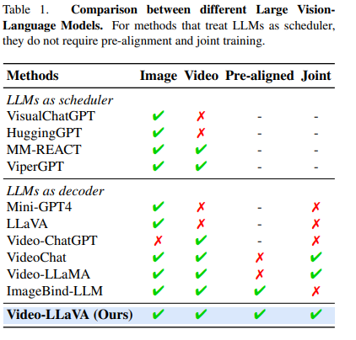
LLVM’S Comparison

Slide 5
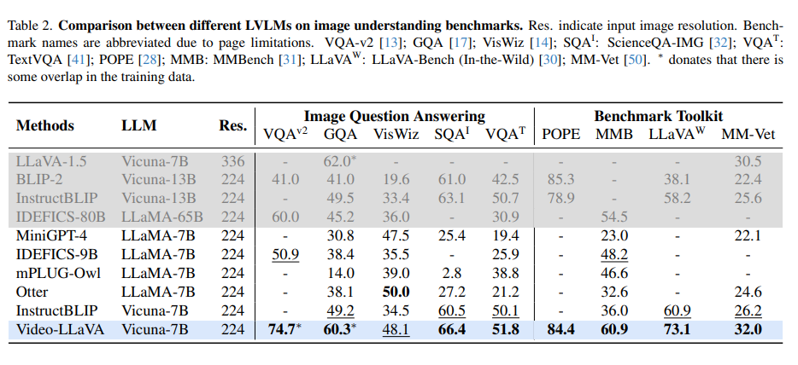
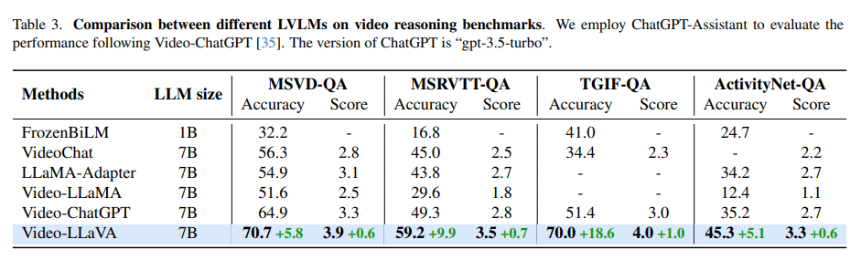
LLVM’S Comparison

Slide 6
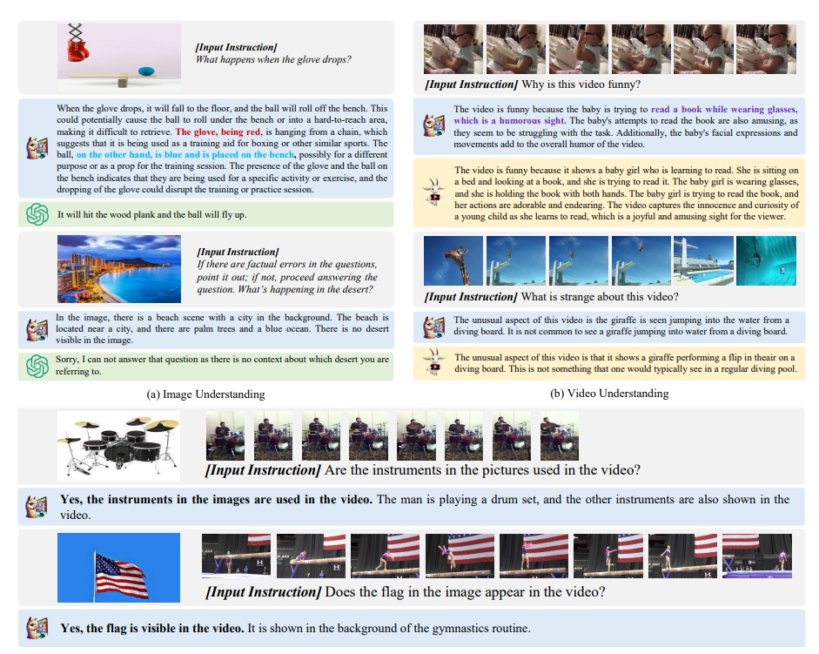
Video LLaVa Inference

Slide 7
Video LLaVa Inference Demo on Video
Sample video: https://huggingface.co/spaces/LanguageBind/Video-LLaVA/blob/main/examples/sample_demo_1.mp4
Ground Truth: In this video, a young child, around 3-4 years old, is trying to read a book while making funny noises and wearing glasses.
ASSISTANT:"
This video is funny because it shows a baby wearing glasses, which is a playful and unexpected sight. The baby is sitting on the floor, and the video captures the baby's movements as it interacts with the camera, which adds a sense of spontaneity and humor to the scene. The fact that the baby is wearing glasses, which is not a common sight for babies, makes the video even more amusing and entertaining.
prompt = "USER: <video> Why is this video funny?

Slide 8
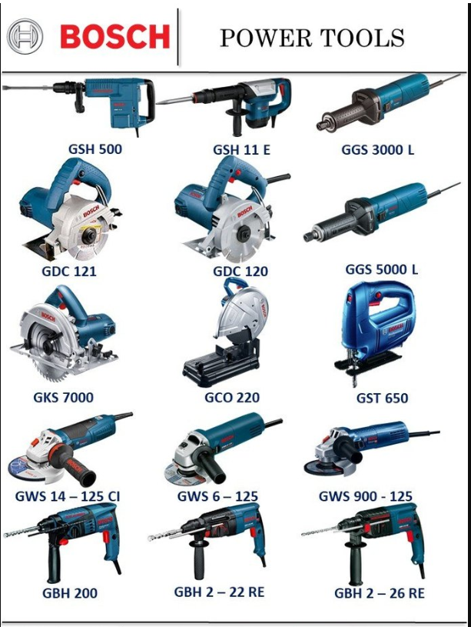
Video LLaVa Inference Demo on Image
prompt = "USER: <image> Describe the image?
ASSISTANT: The image is a large collection of various power tools, including different types of saws, hammers, and drills. The tools are arranged in rows, showcasing their different designs, sizes, and features. The collection spans across the entire image, providing a comprehensive overview of the available power tools. The tools vary in color, size, and design, offering a wide selection for users to choose from based on their needs and preferences.

Slide 9
Applications of Video LLaVA
Automated Captioning
Intelligent Retrieval
Video Surveillance
Content Creation
Healthcare
Autonomous Vehicles

Slide 10
References
Video-LLaVa paper: https://arxiv.org/pdf/2311.10122
https://github.com/PKU-YuanGroup/Video-LLaVA
https://github.com/tkhan11/Video-LLaVA
https://huggingface.co/spaces/LanguageBind/Video-LLaVA
https://medium.com/@takhan.11/introducing-video-llava-unifying-vision-and-language-ai-for-images-and-videos-59fc61fa7233

Slide 11
Thank You

